Slide 1
Dog Breed Identification
Jahin Mahbub
1531552042
Sec:02
Summer:2020

Slide 2
Introduction
In this presentation today, we will go through TF2.0 Keras to build a Convolutional Neural Network that helps us to identify the breed of a dog from its image. In the process, we will use Transfer Learning and learn how to design, train and test models with the provided dataset.
We are going to use the Dog Breed Identification dataset which can be easily downloaded from the Kaggle datasets. The dataset is designed for multiclass classification problem as it has 120 breeds of dogs.
We are going to use the Convolutional Neural Network . Specifically Transfer Learning. Here we use MobileNev2 as the pre-trained model.
Github Repository :

Slide 3
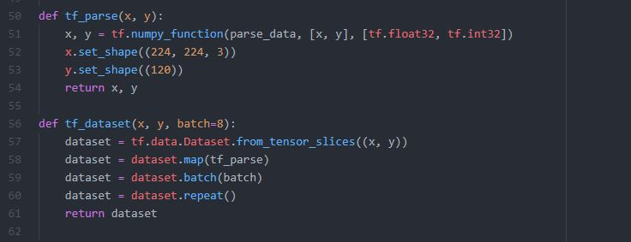
Data Processing
In the process , we will first create a function that is going to read the image from the path and also resize it to the desired size. Then, we perform normalization to make the image pixels smaller by dividing them with the 255.
Now we will use TensorFlow tf.data functions to create the dataset pipeline for training. The tf.parse function preprocess the single instance of the complete dataset. It preprocesses a single image and its label and return it to the dataset function.

Slide 4
Training
Till now we have built the model and the training dataset pipeline. Now we are ready the training the model on the actual dataset. First we set the desired path for the training images and the labels.csv file with contain the name of the breeds. we split the dataset in the training and validation set by 80/20 ratio. In every Train our Batch size was 224.
I have made 4 different Tests.
Test 1 was using 1000 images and 2 epoch. Accuracy : 54.41%
Test 2 was using 5000 images and 5 epoch. Accuracy : 99.95%
Test 3 was using 1000 images and 10 epoch. Accuracy : 98.03% (Validated with 200 images)
Test 4 was using 10222 images and 15 epoch. Accuracy : 100%

Slide 5
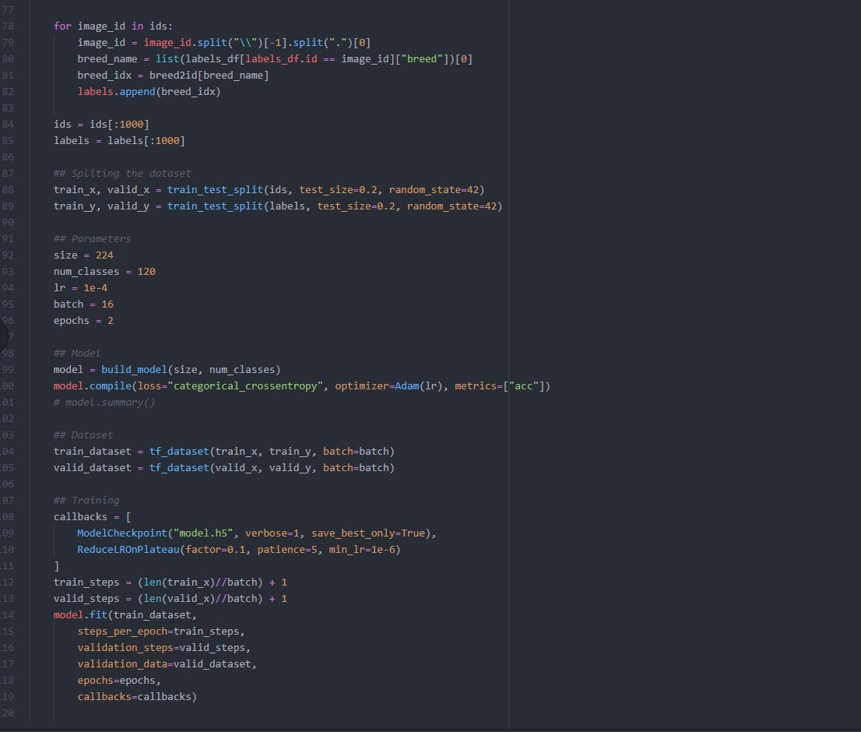
Test 1

Slide 6
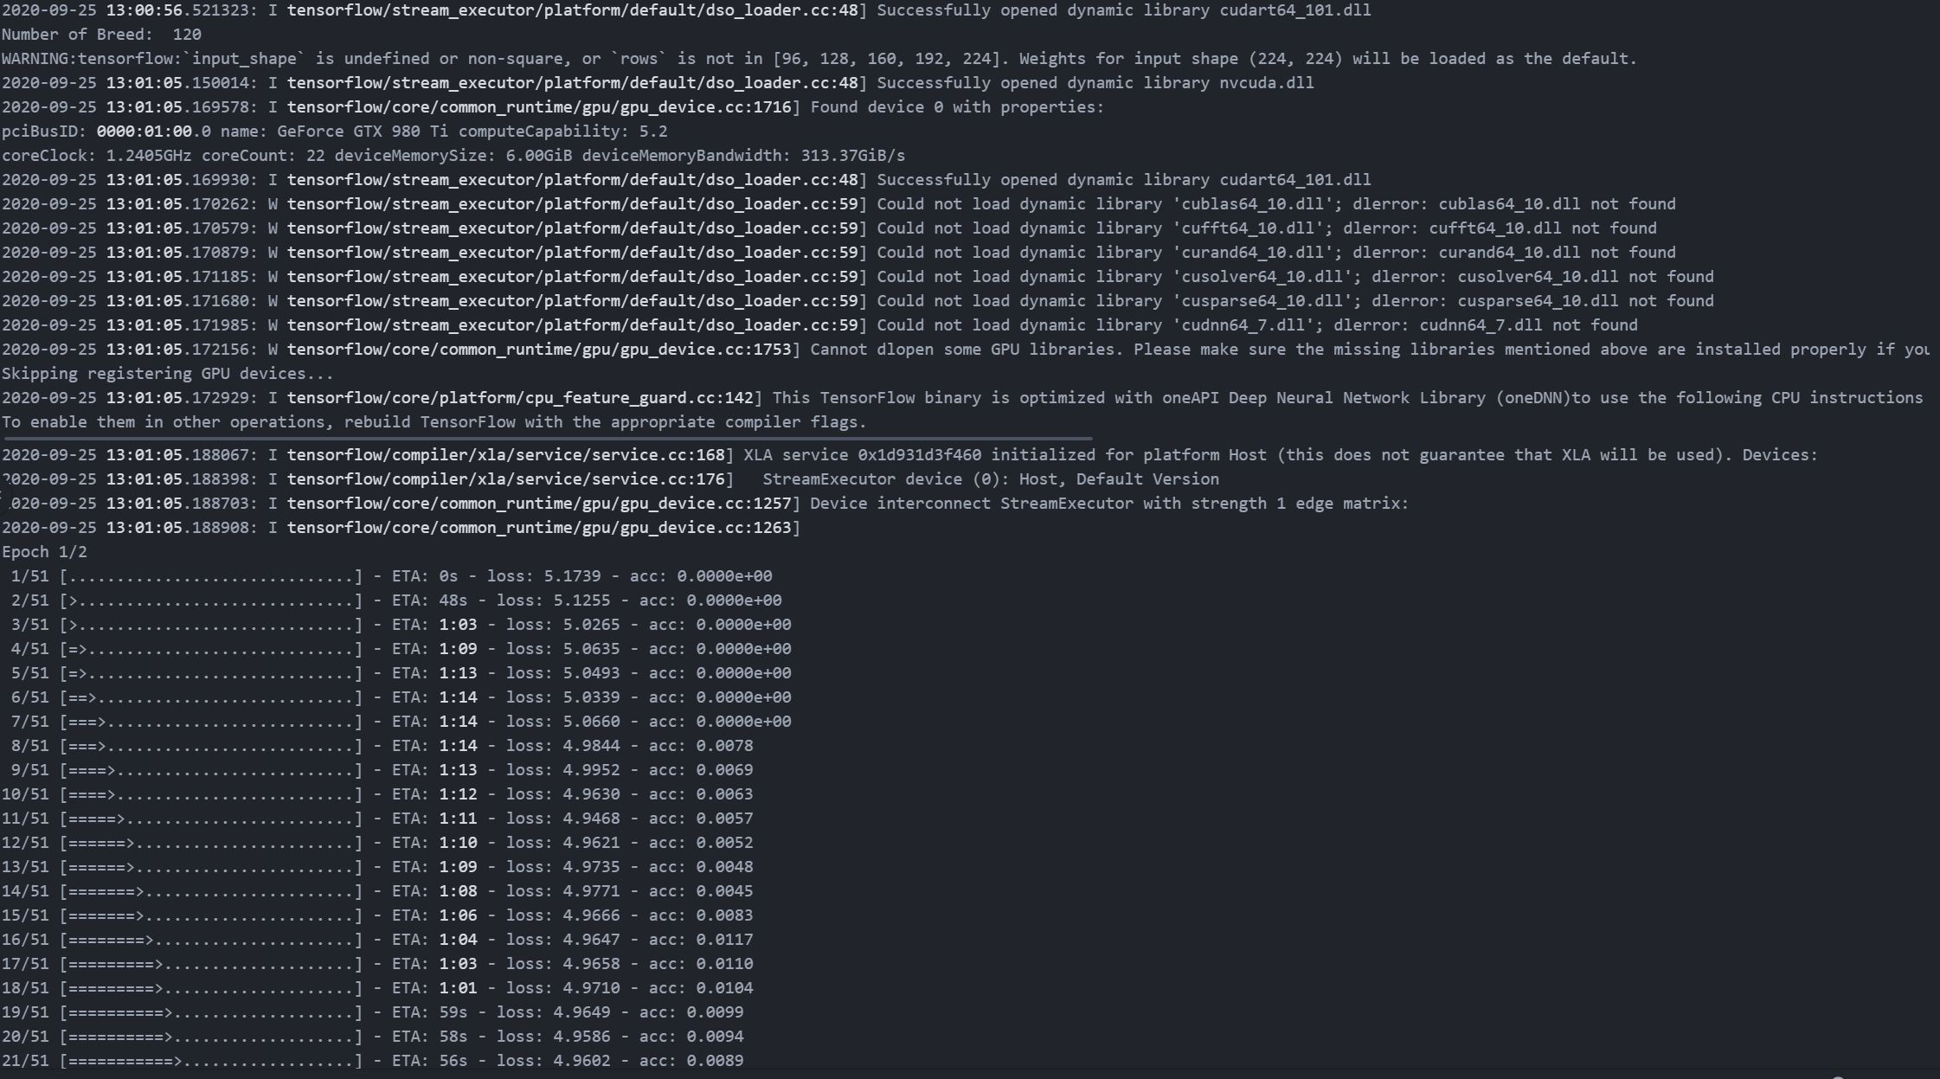
Test 1

Slide 7
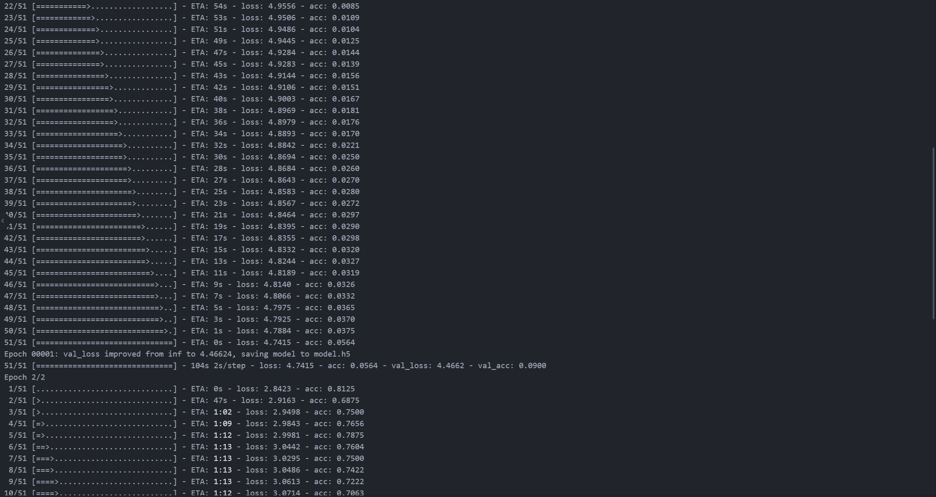
Test 1

Slide 8
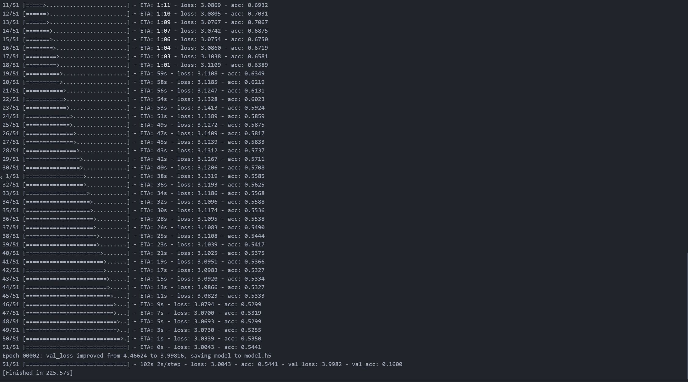
Test 1

Slide 9
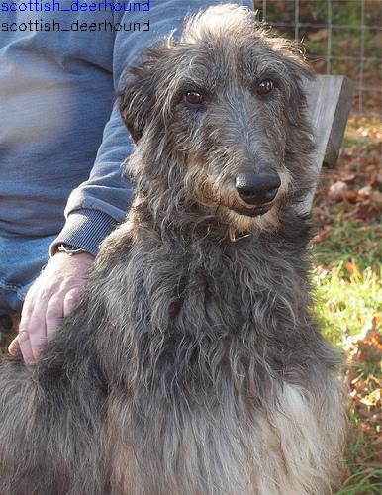
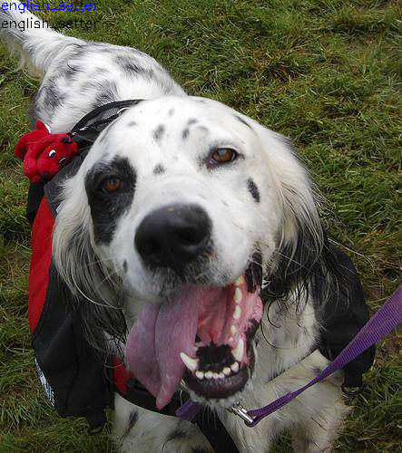
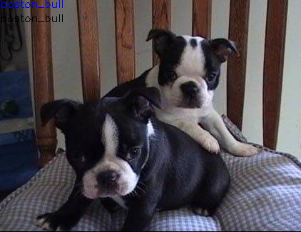
Test 1

Slide 10
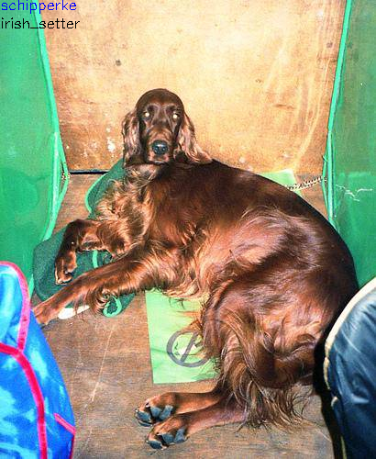
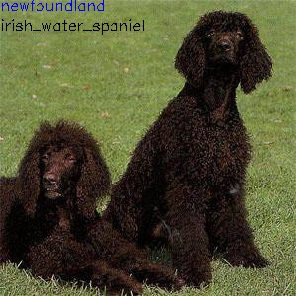
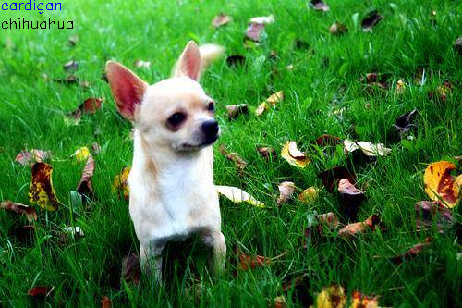
Test 1

Slide 11
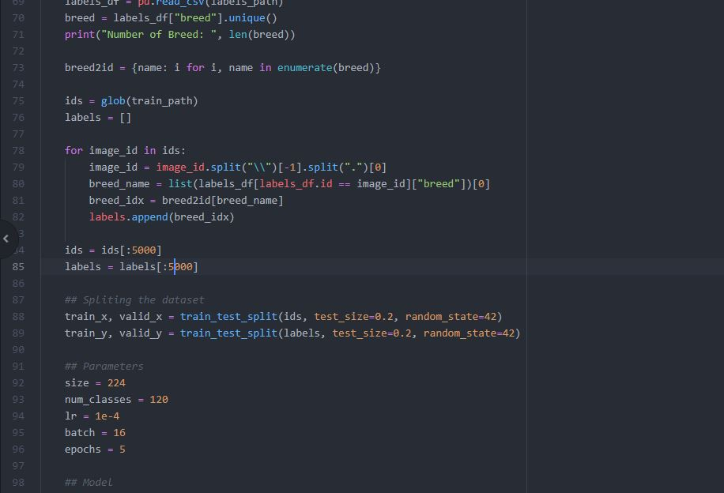
Test 2

Slide 12
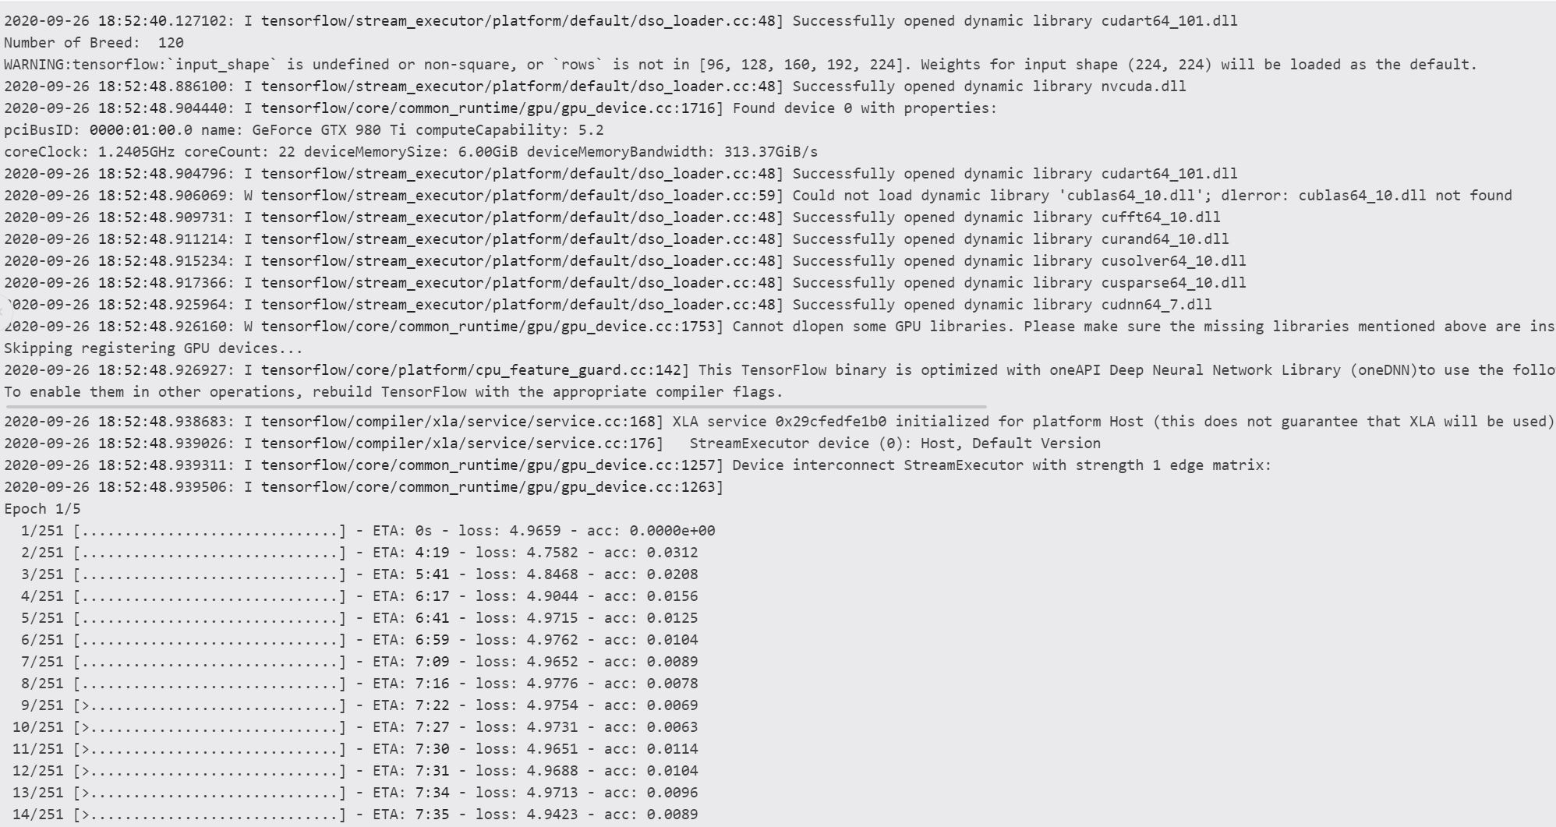
Test 2

Slide 13
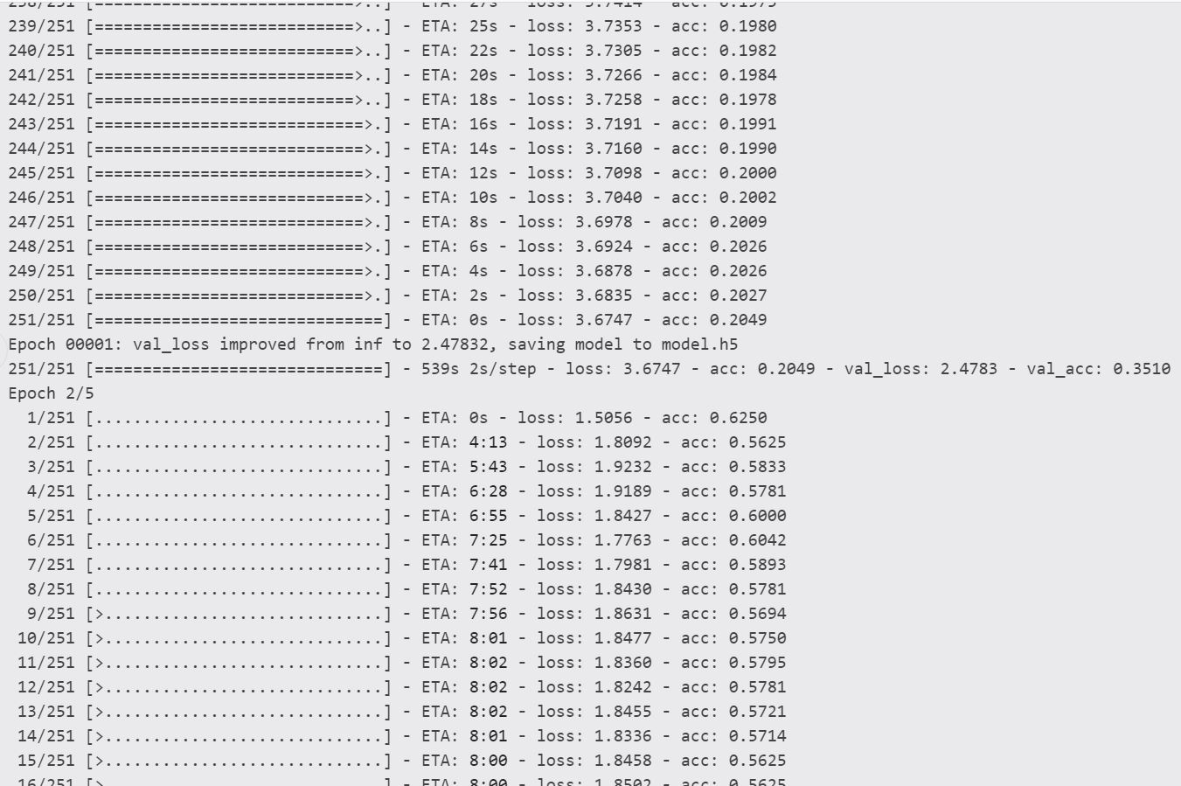
Test 2

Slide 14
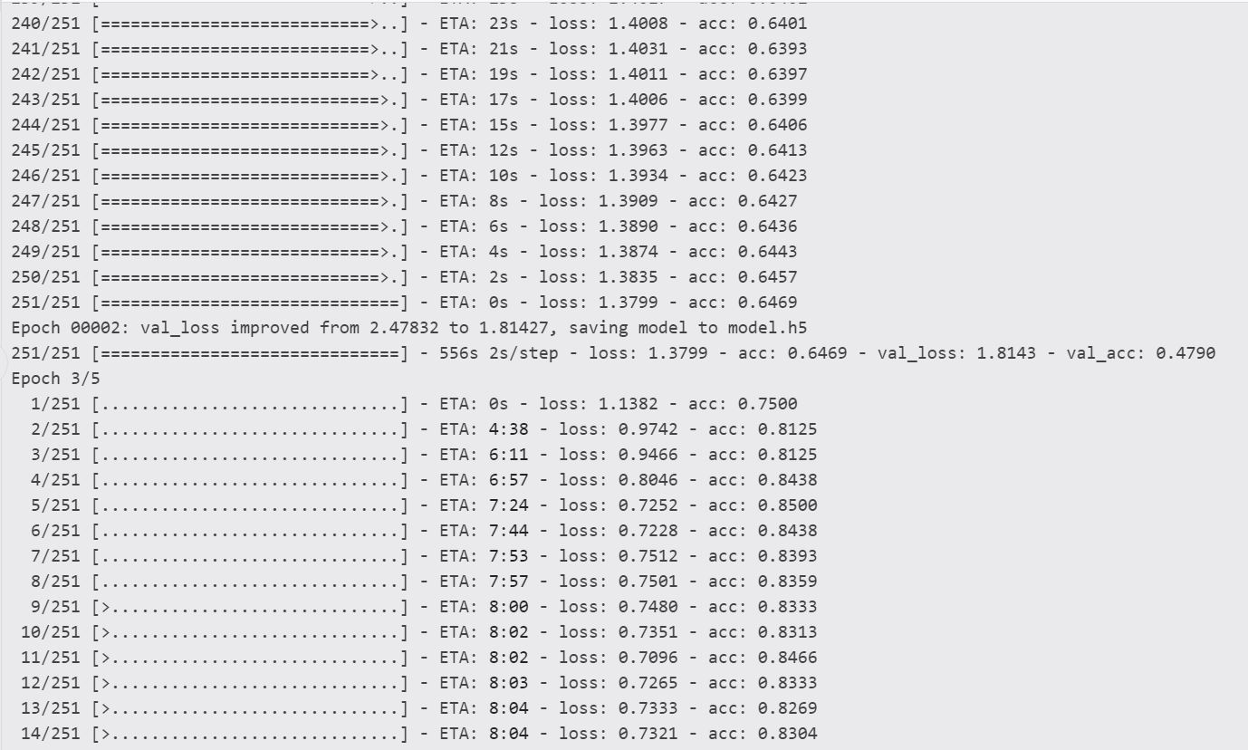
Test 2

Slide 15
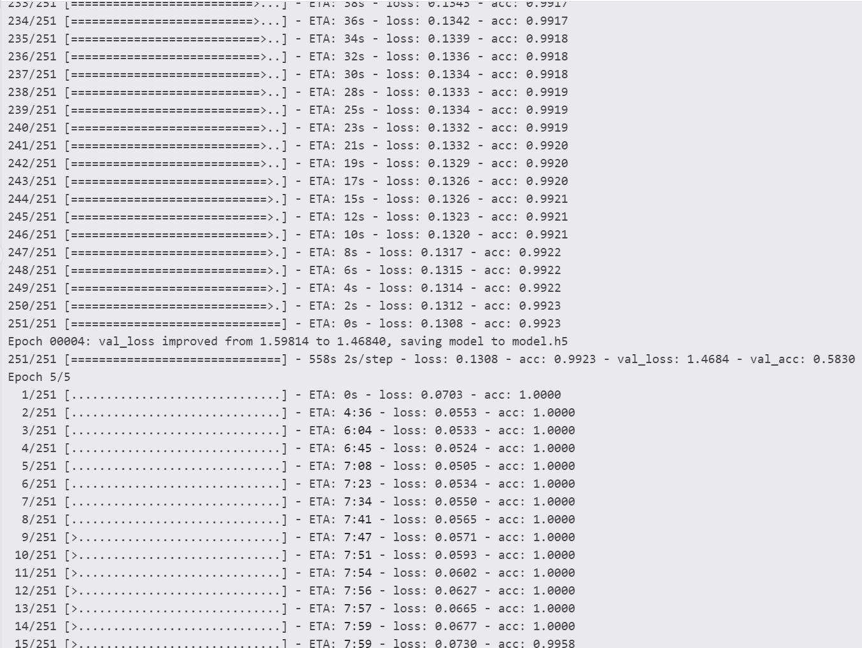
Test 2

Slide 16
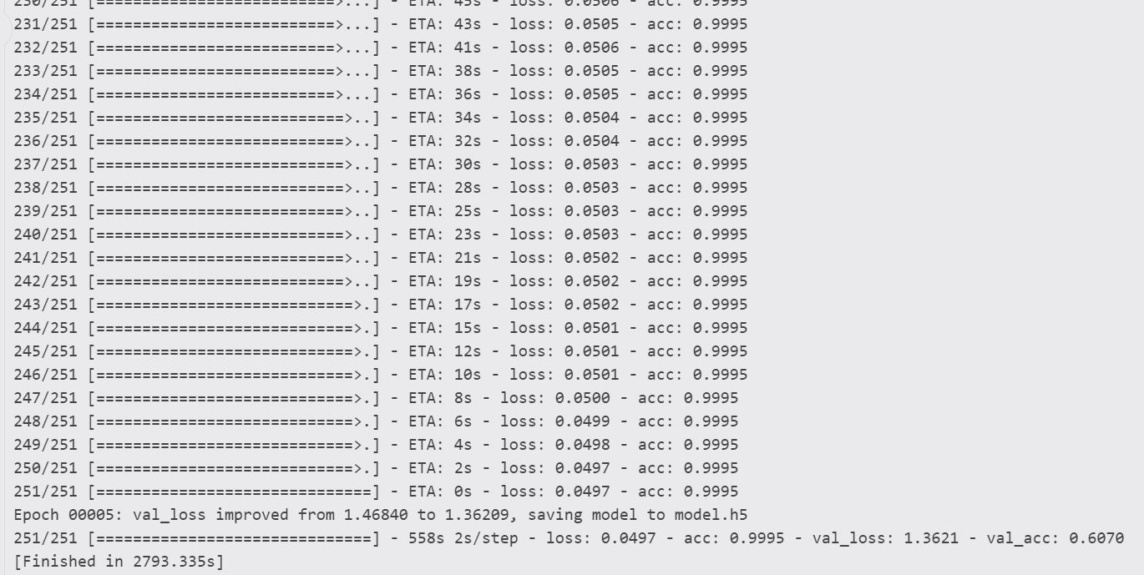
Test 2

Slide 17
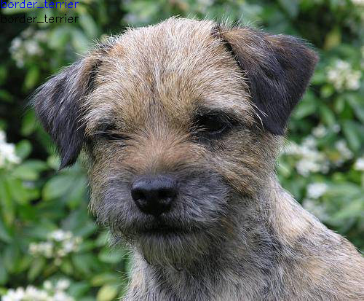
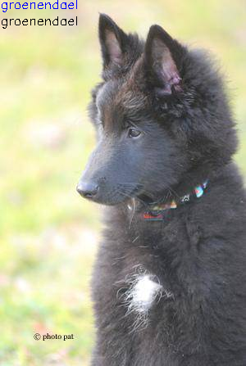
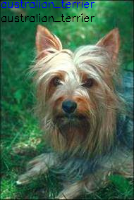
Test 2

Slide 18
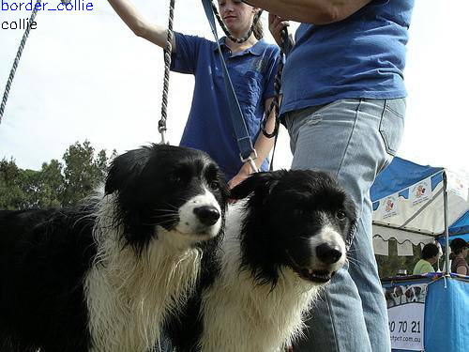
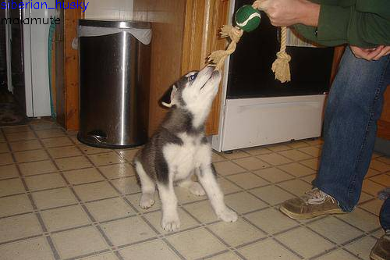
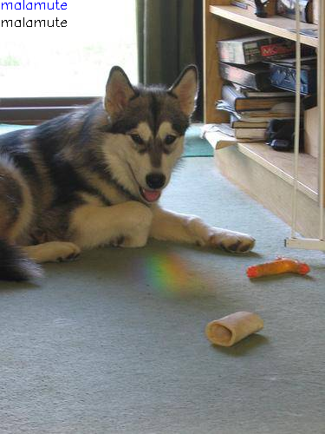
Test 2

Slide 19
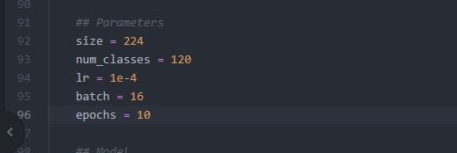
Test 3

Slide 20
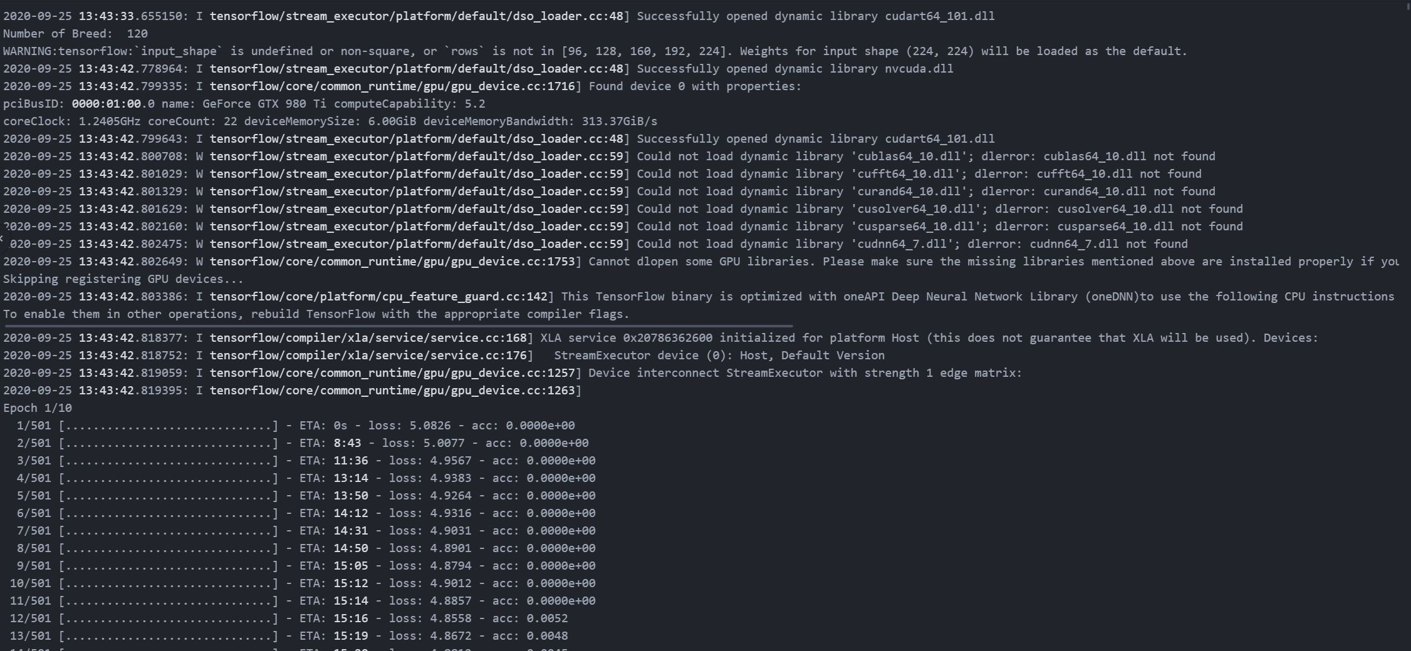
Test 3

Slide 21
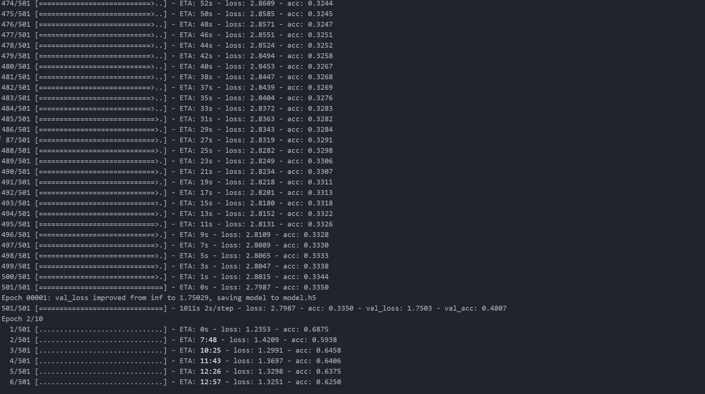
Test 3

Slide 22
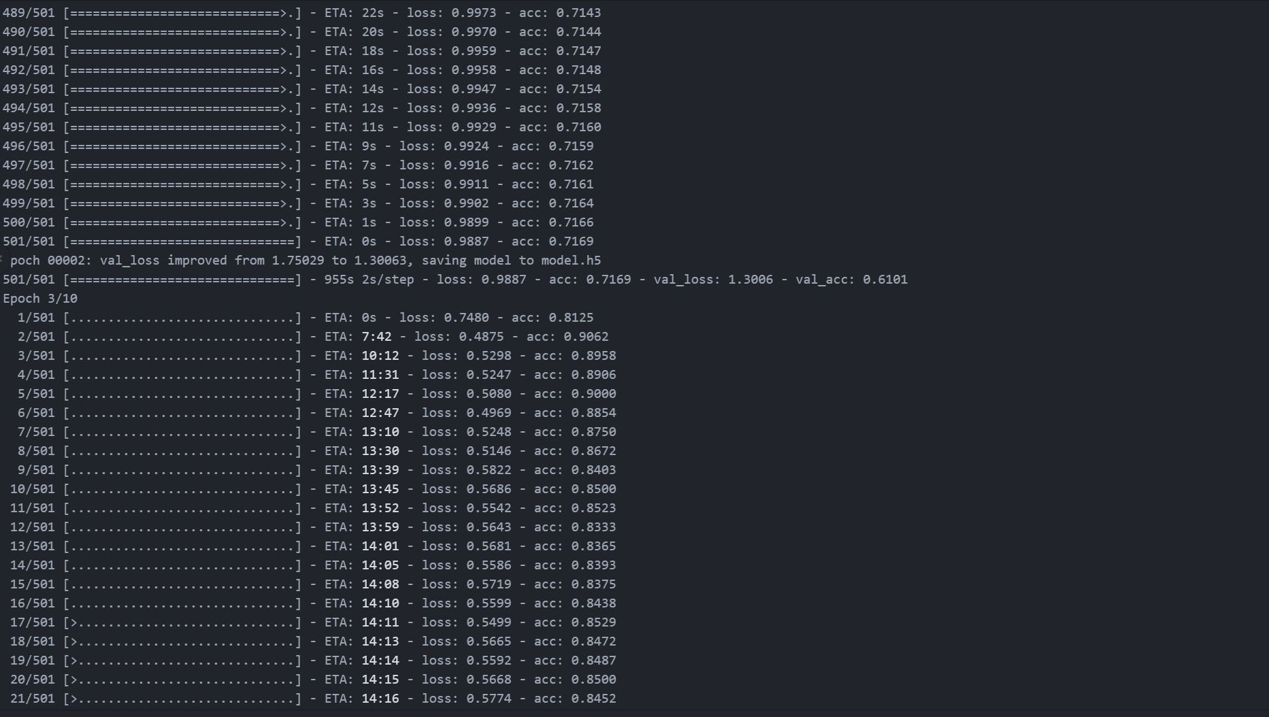
Test 3

Slide 23
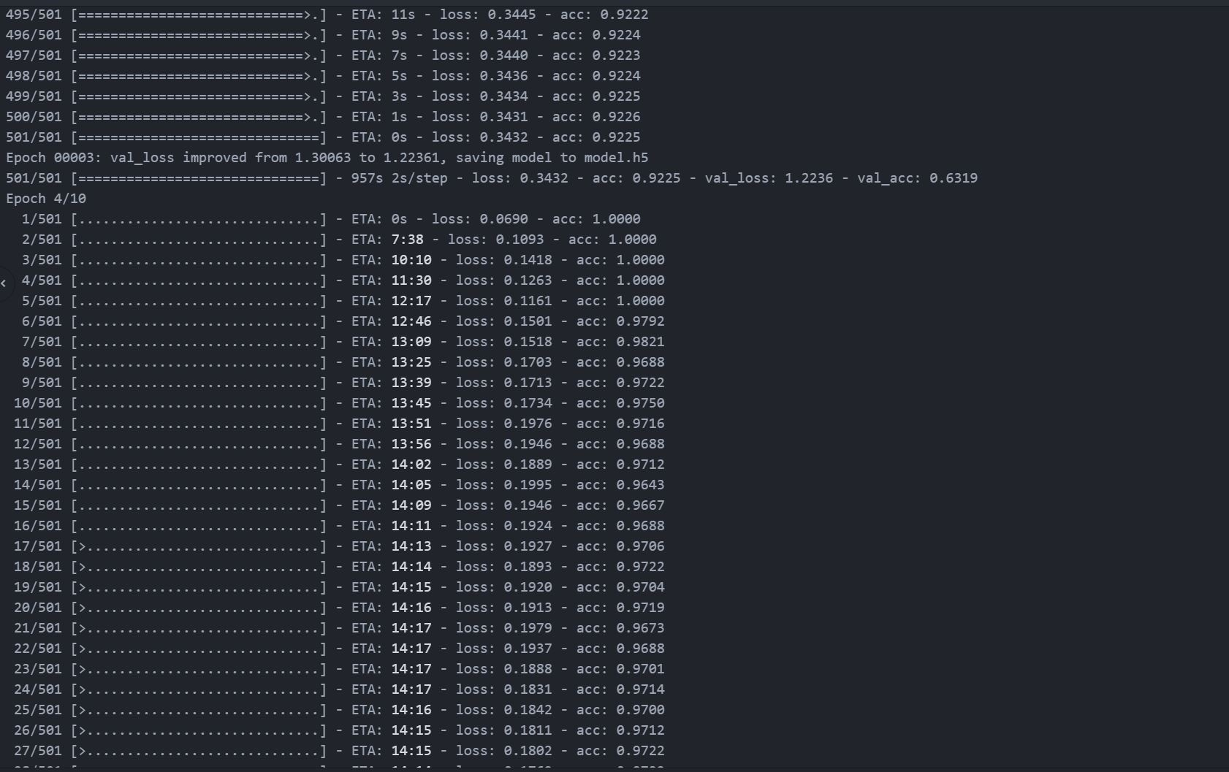
Test 3

Slide 24
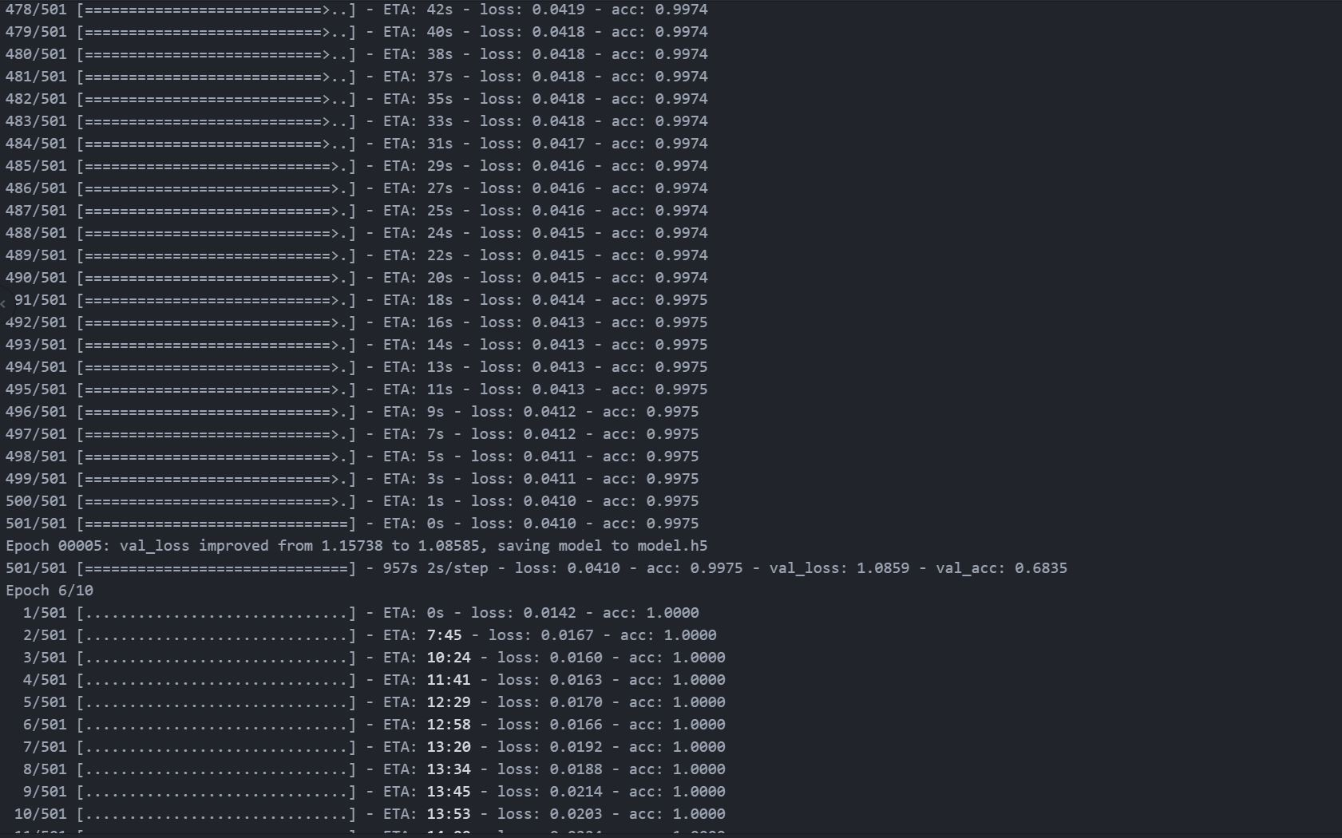
Test 3

Slide 25
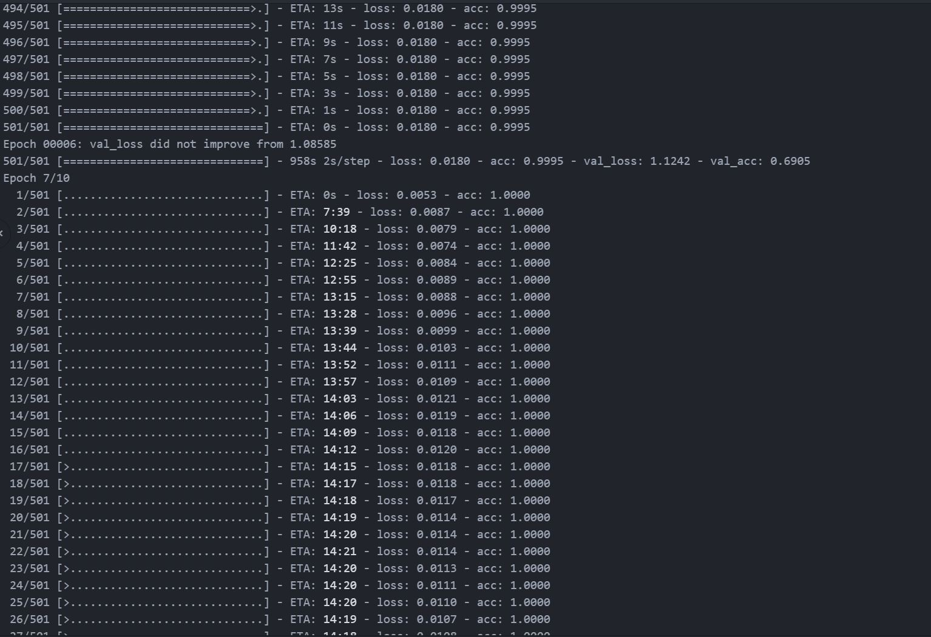
Test 3

Slide 26
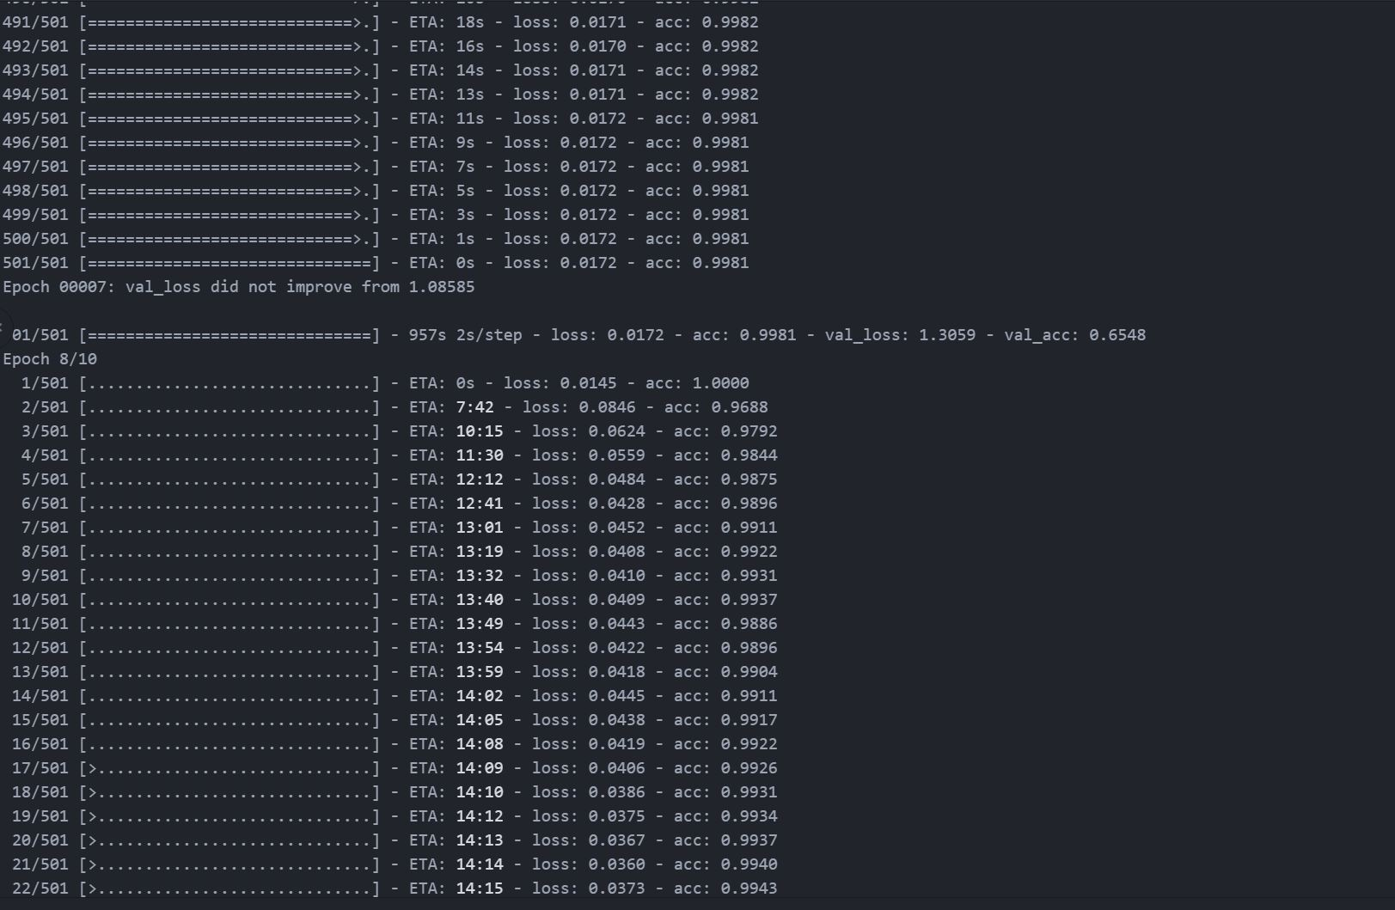
Test 3

Slide 27
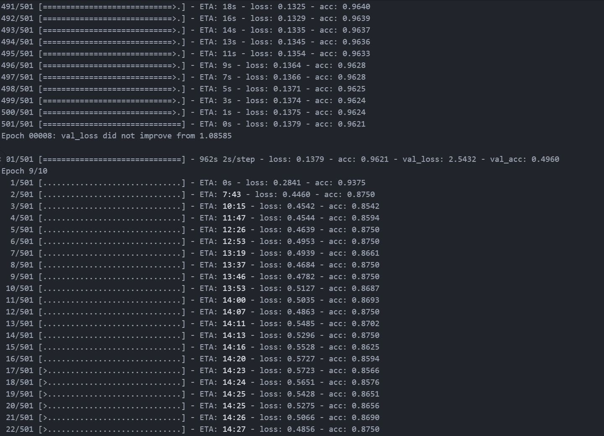
Test 3

Slide 28
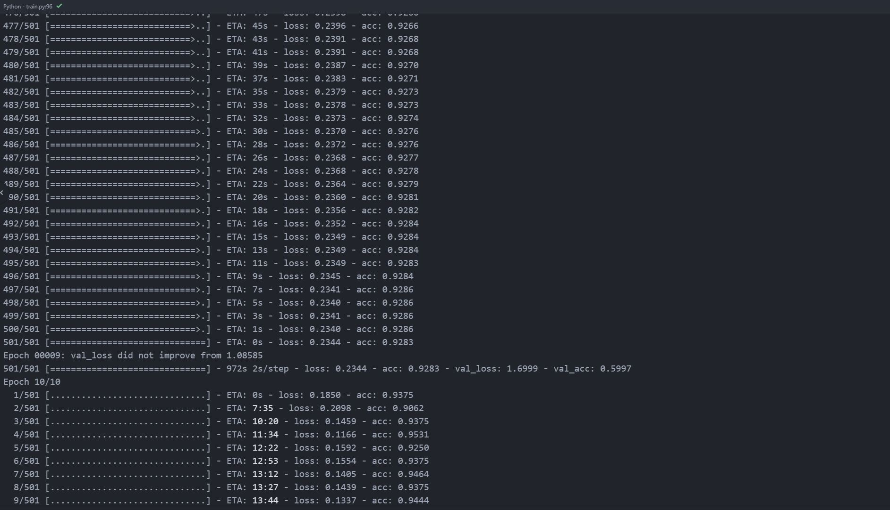
Test 3

Slide 29
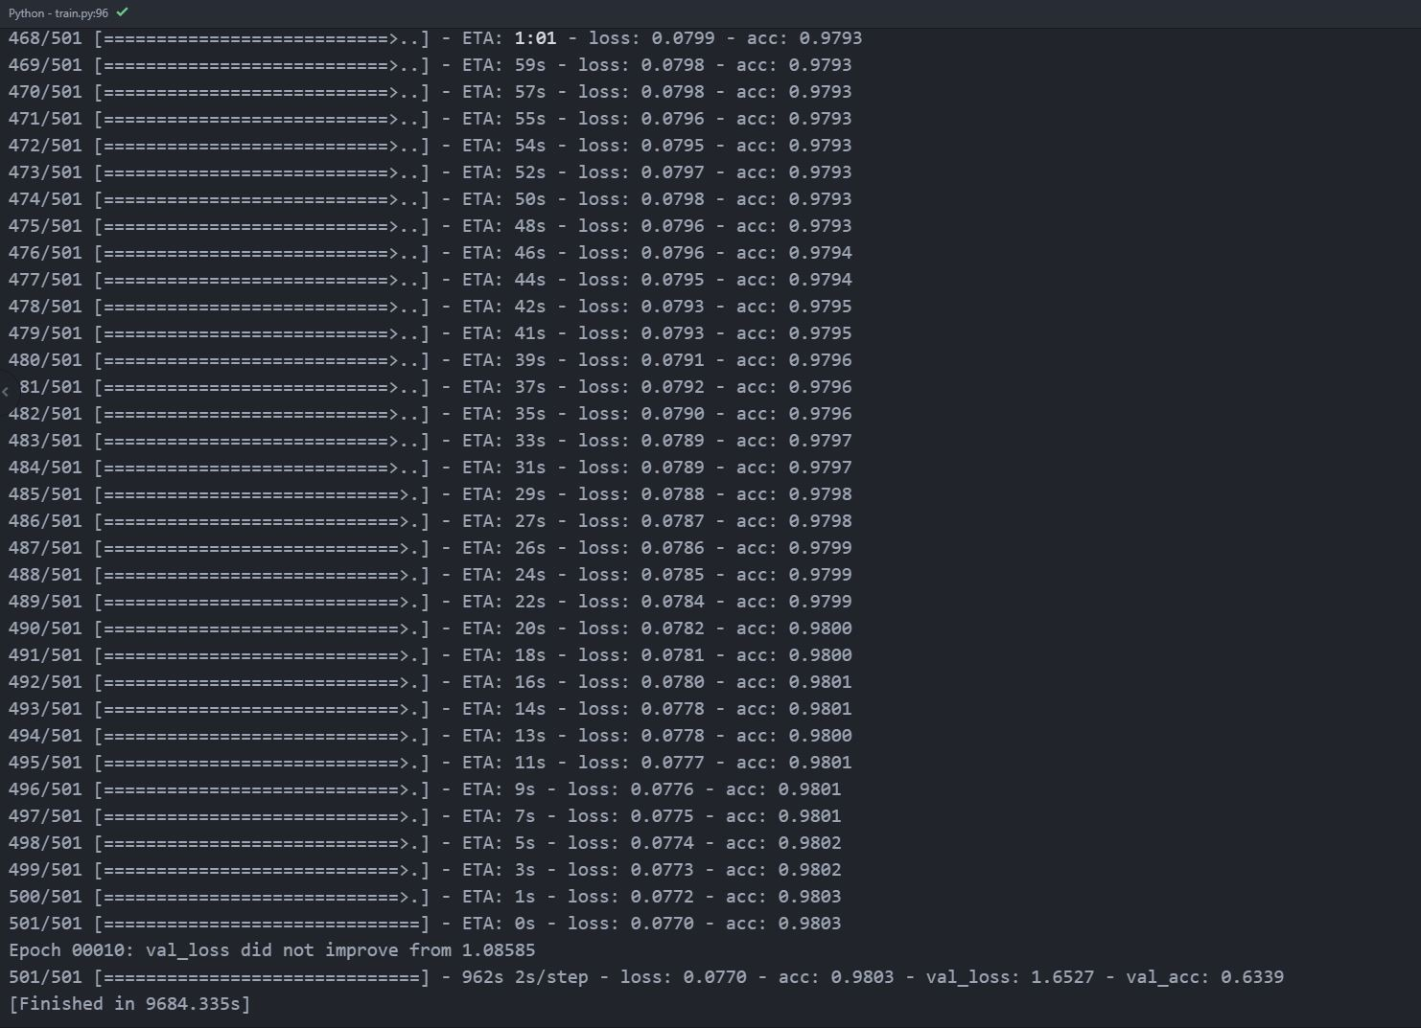
Test 3

Slide 30

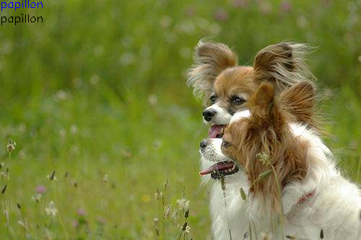
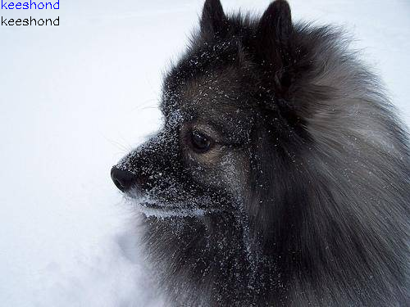
Test 3

Slide 31
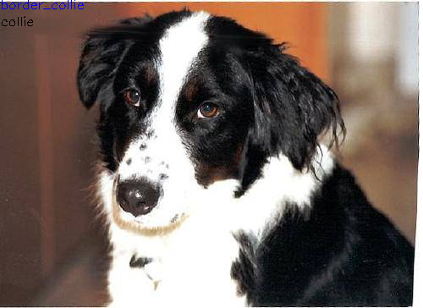
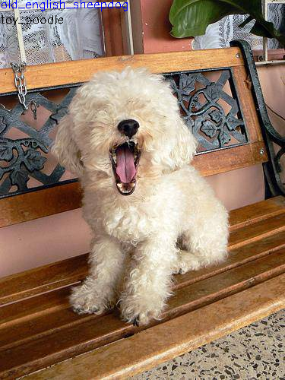
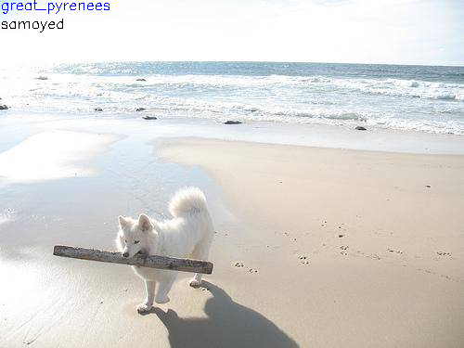
Test 3

Slide 32
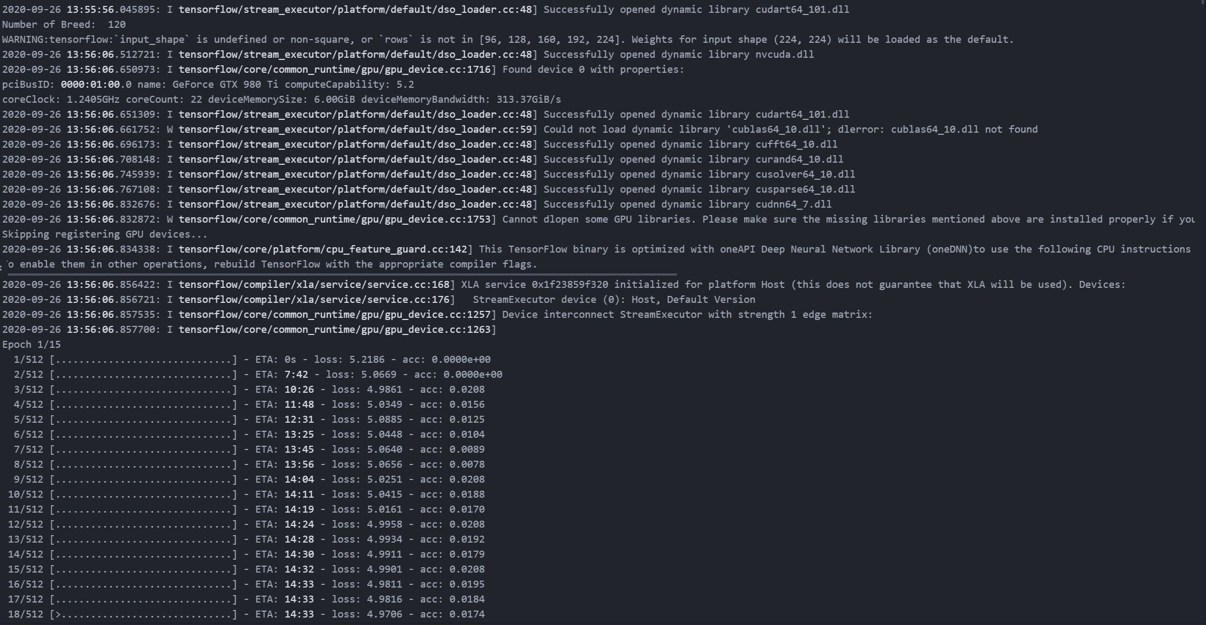
Test 4

Slide 33
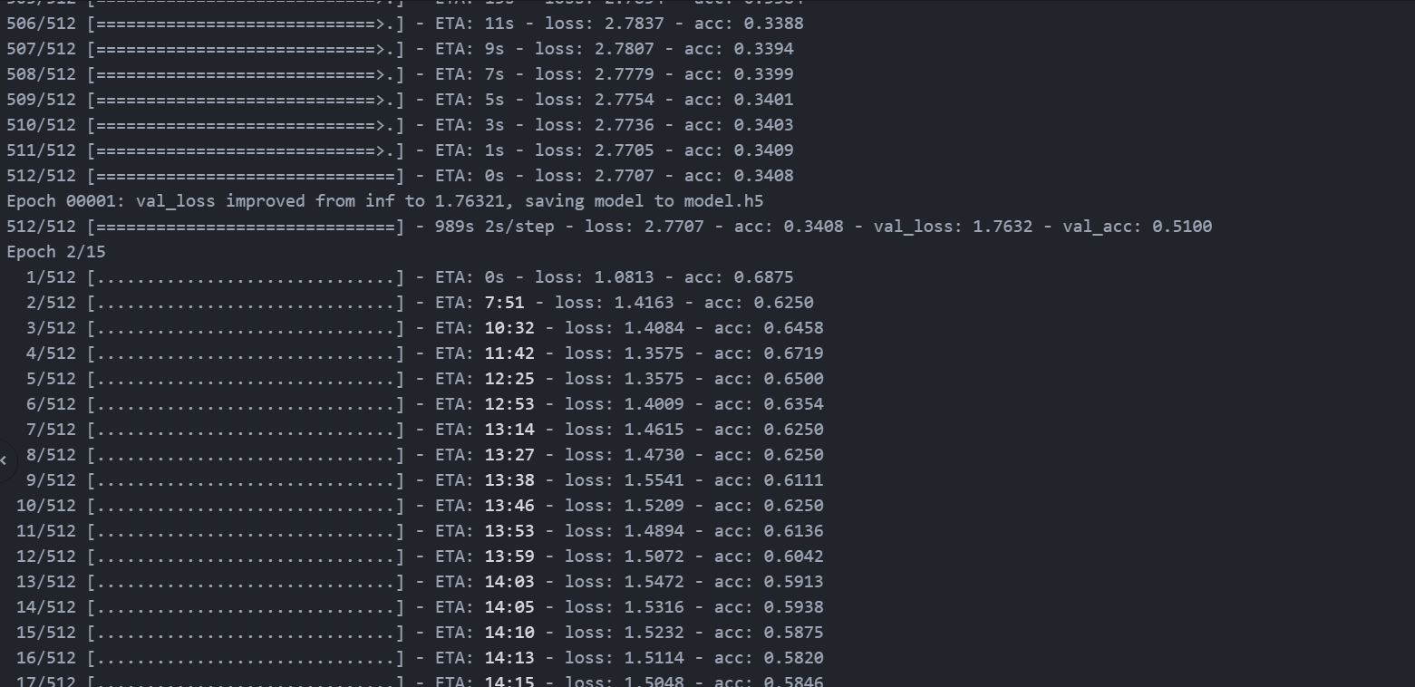
Test 4

Slide 34
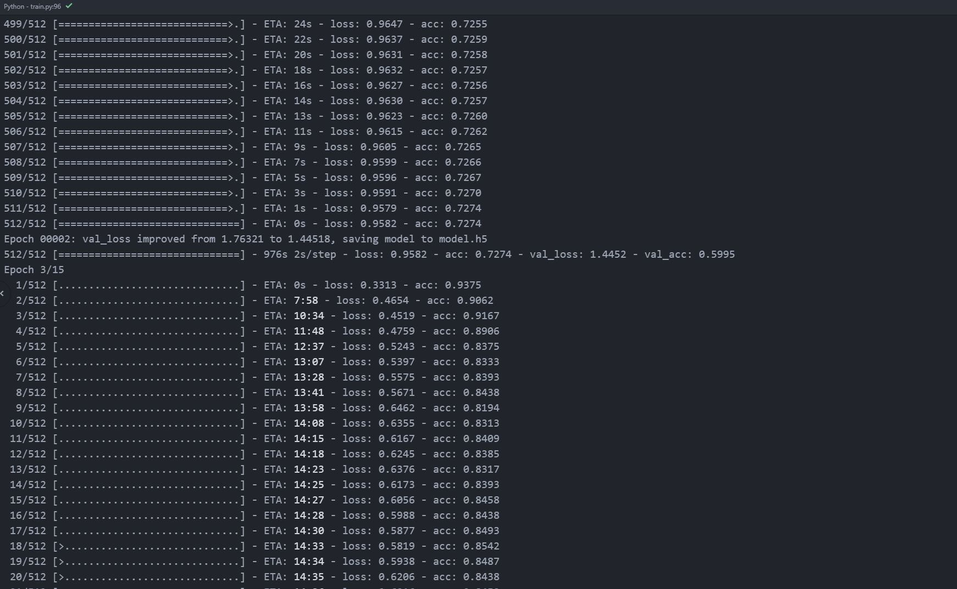
Test 4

Slide 35
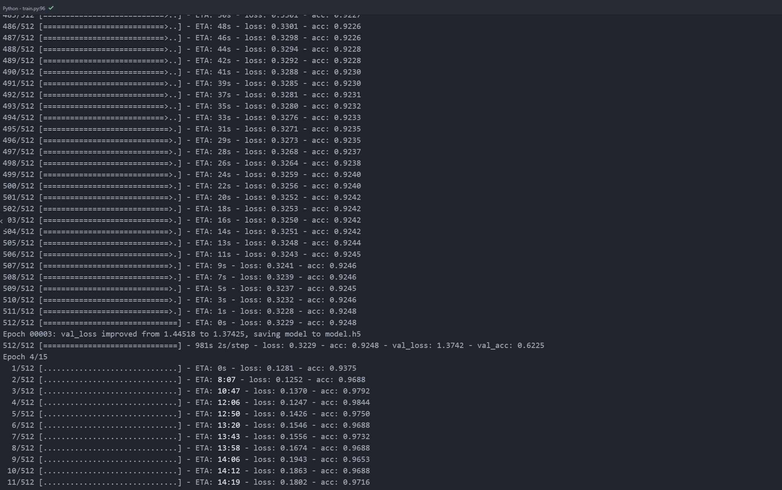
Test 4

Slide 36
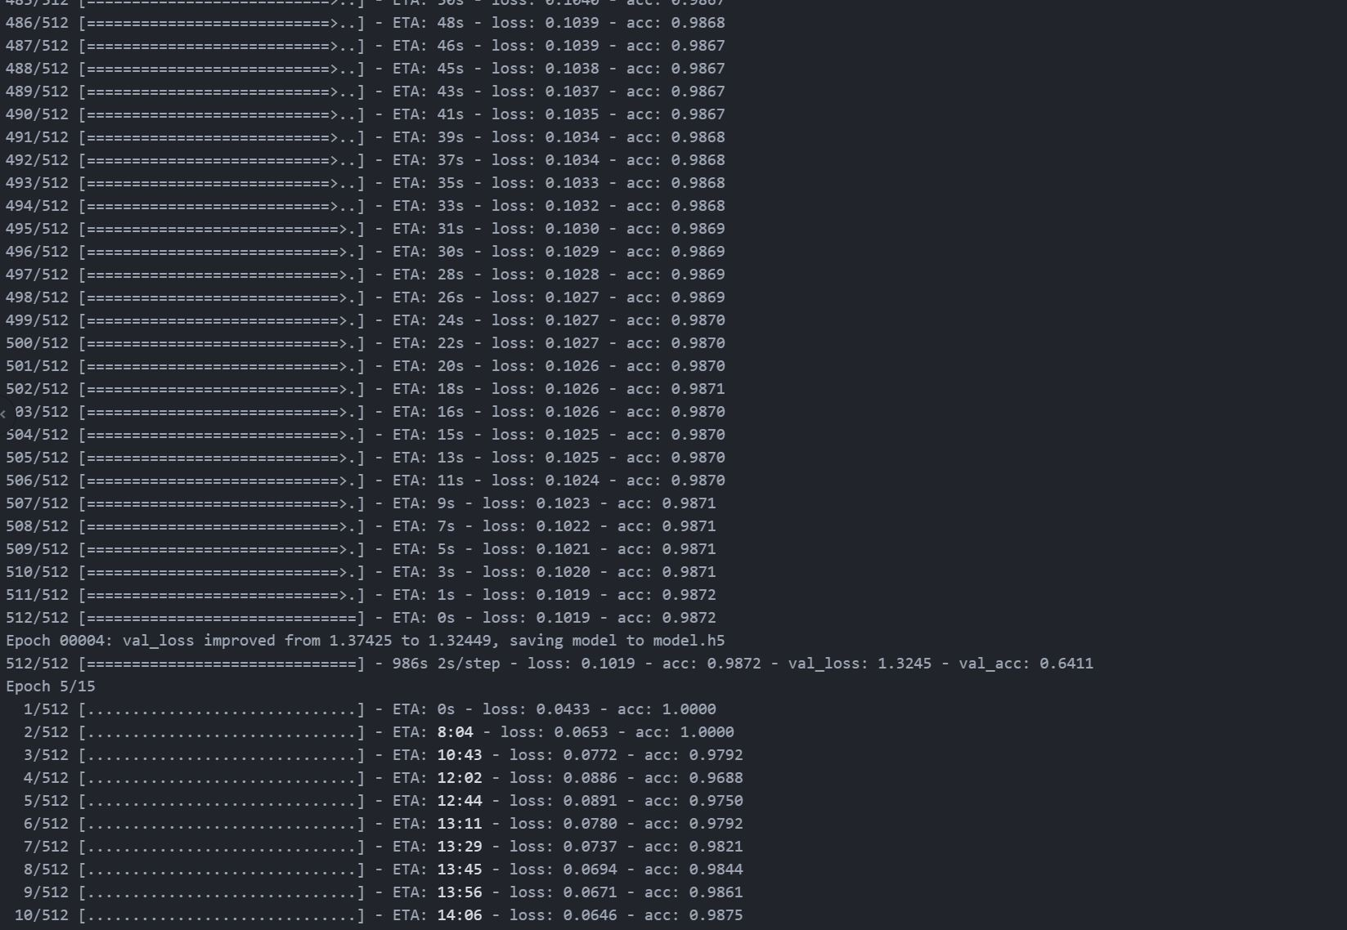
Test 4

Slide 37
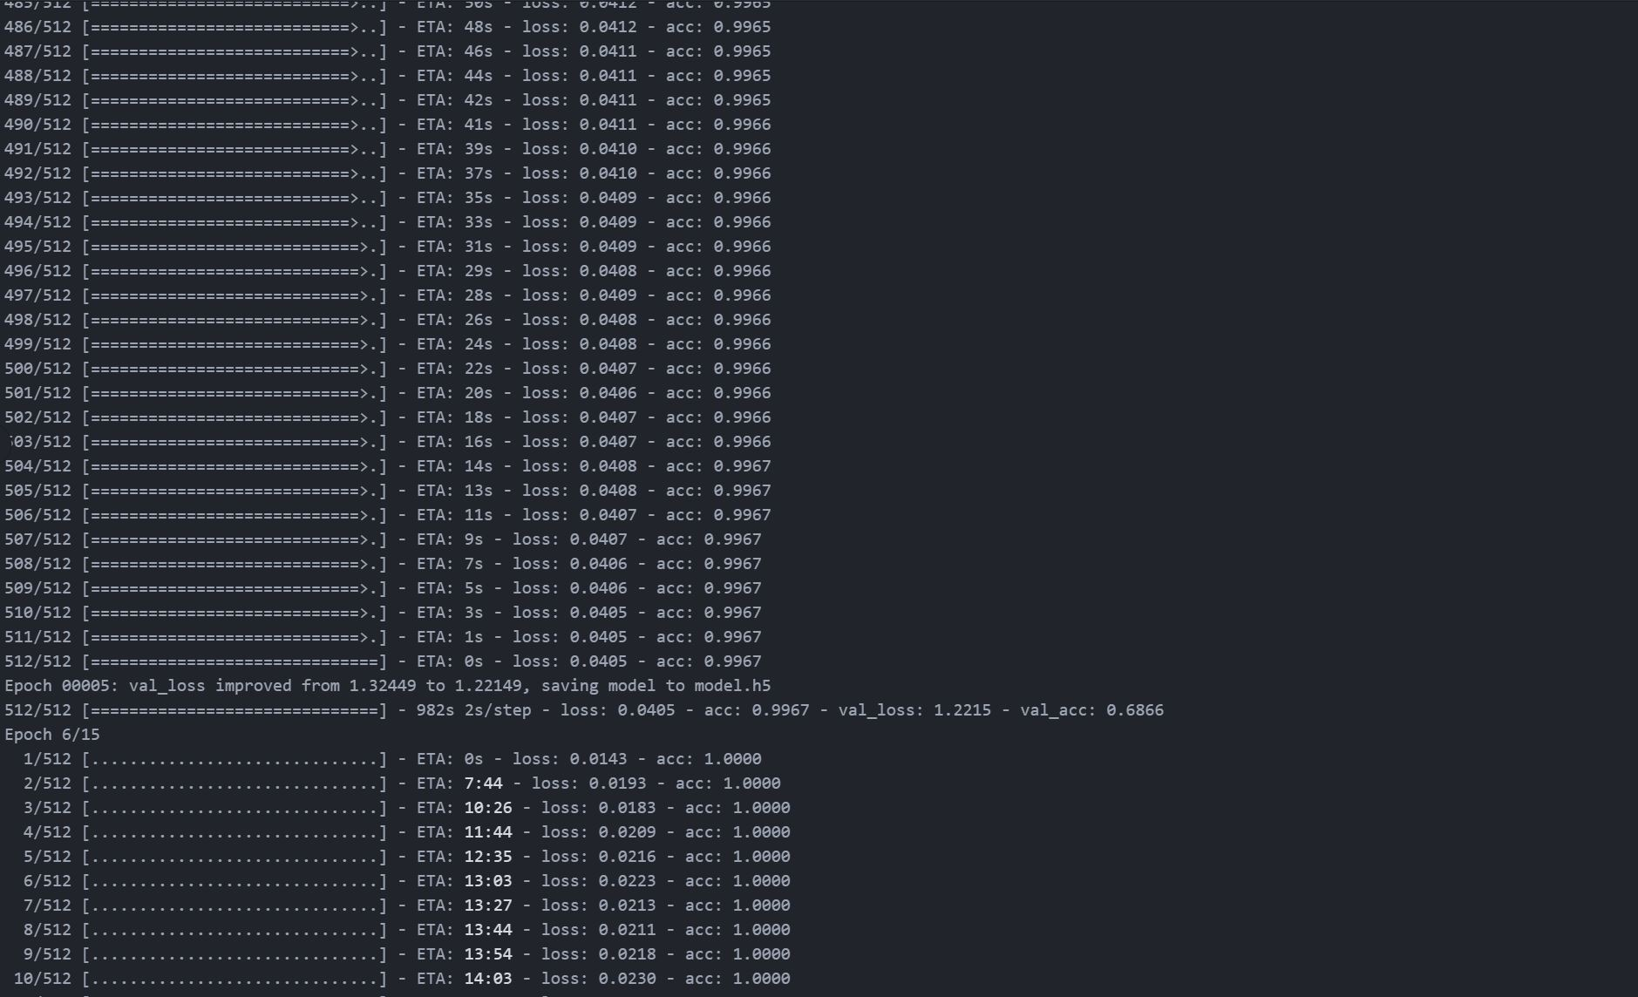
Test 4

Slide 38
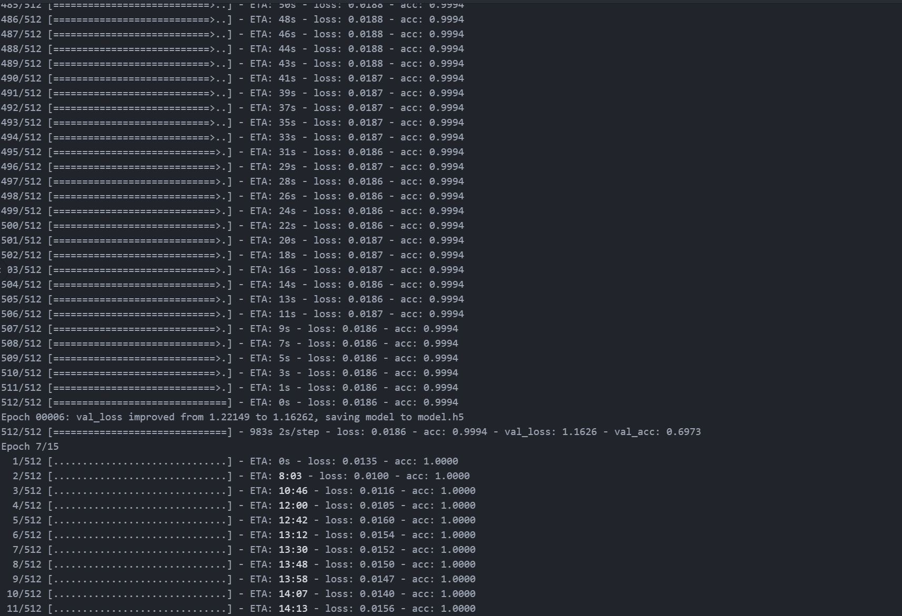
Test 4

Slide 39
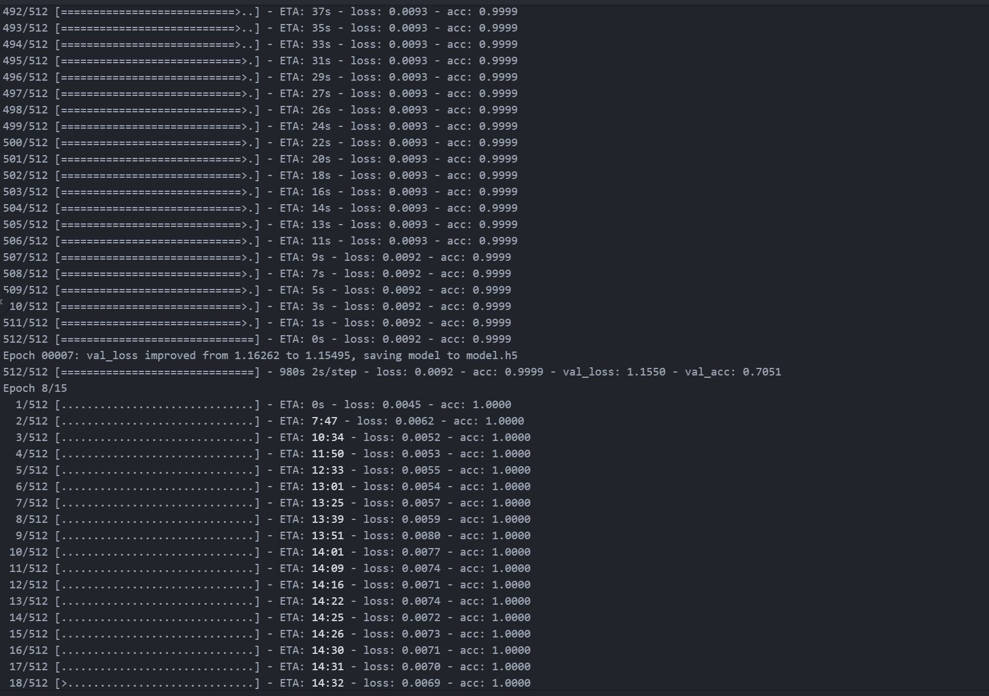
Test 4

Slide 40
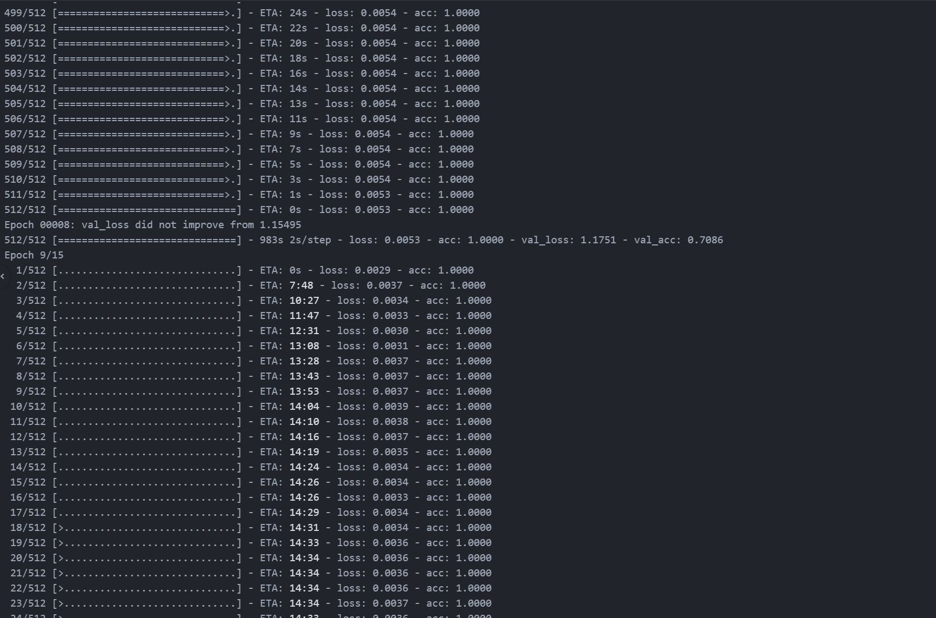
Test 4

Slide 41
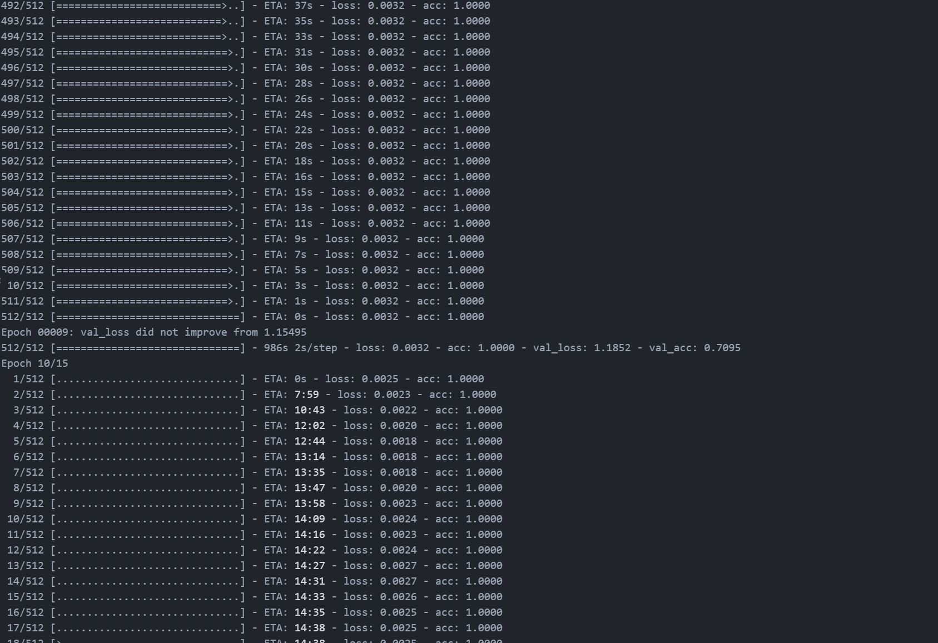
Test 4

Slide 42
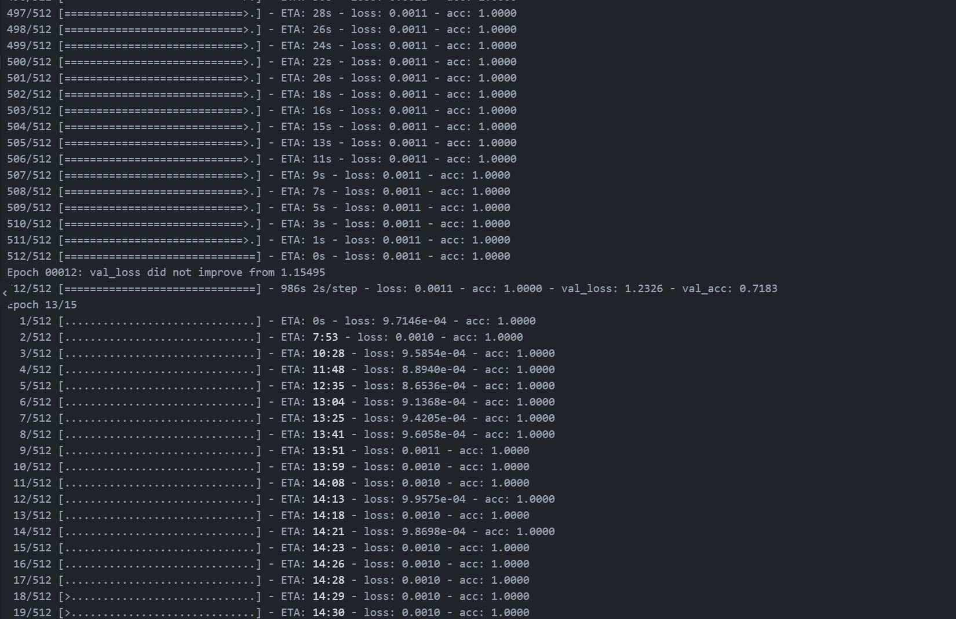
Test 4

Slide 43

Test 4

Slide 44

Test 4

Slide 45

Test 4

Slide 46






Test 4

Slide 47
Thank You !
Any Questions?

